Slide 1
Game Library
Daniel Tucker
Jose Gonzalez

Slide 2
Library Description
Project is a library of video games and information relating to them
Users can make edits to the library
Can add new information to current videos games, publishers, ratings, etc. in the library
Can remove or clear current information from the library
Authentication will be done on every user edit
Users can search for specific games and their aspects and relationships
Users can filter games by genre, rating, publisher, developer, release date, etc.

Slide 3
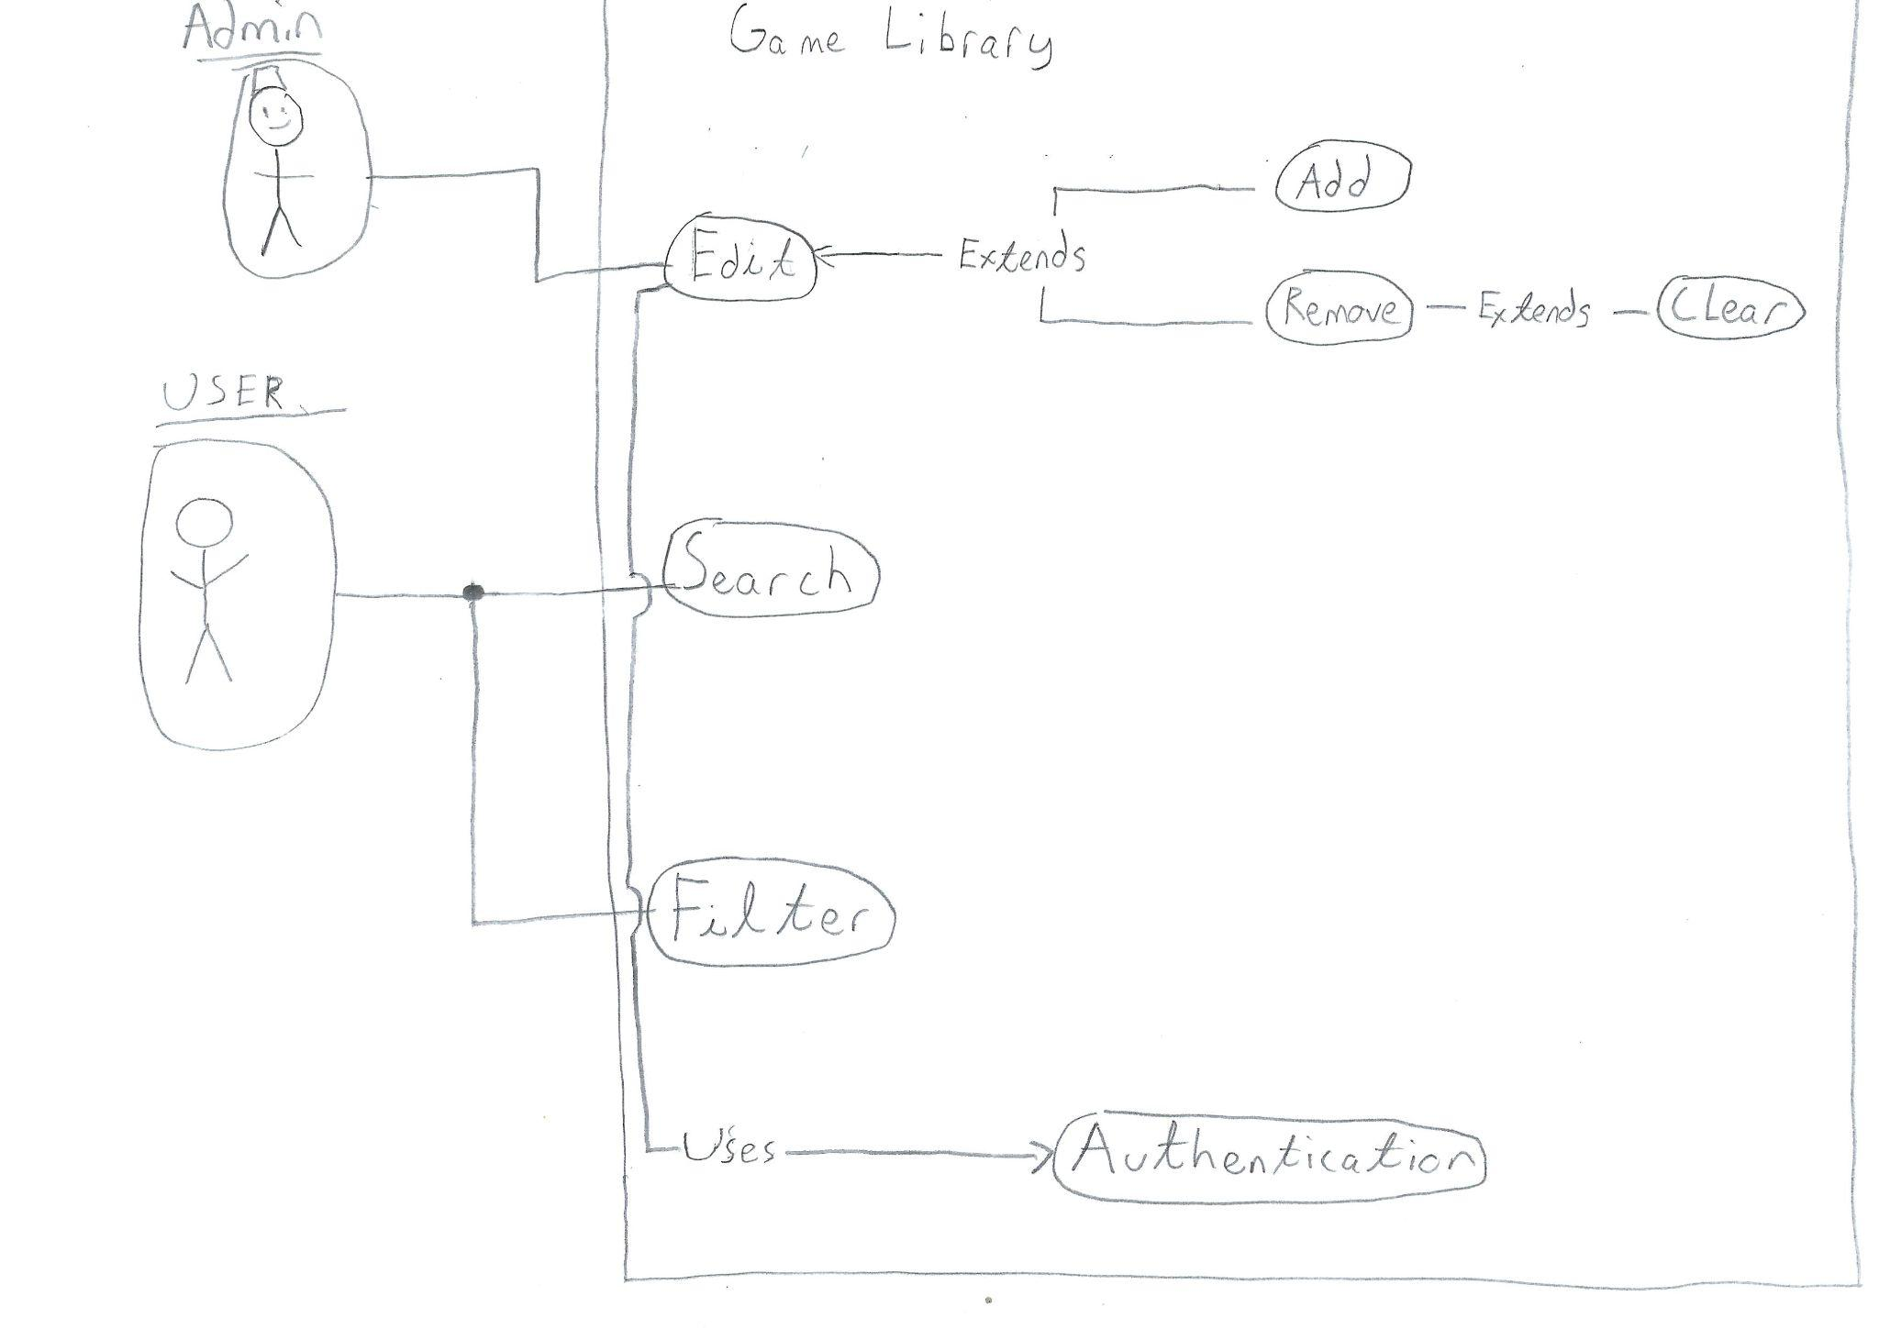
Use-Case Diagram

Slide 4
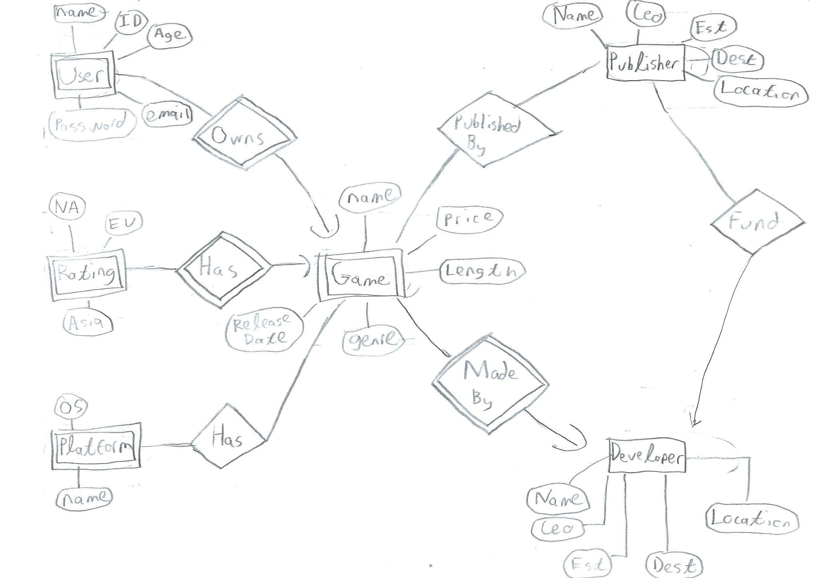
E/R Diagram

Slide 5
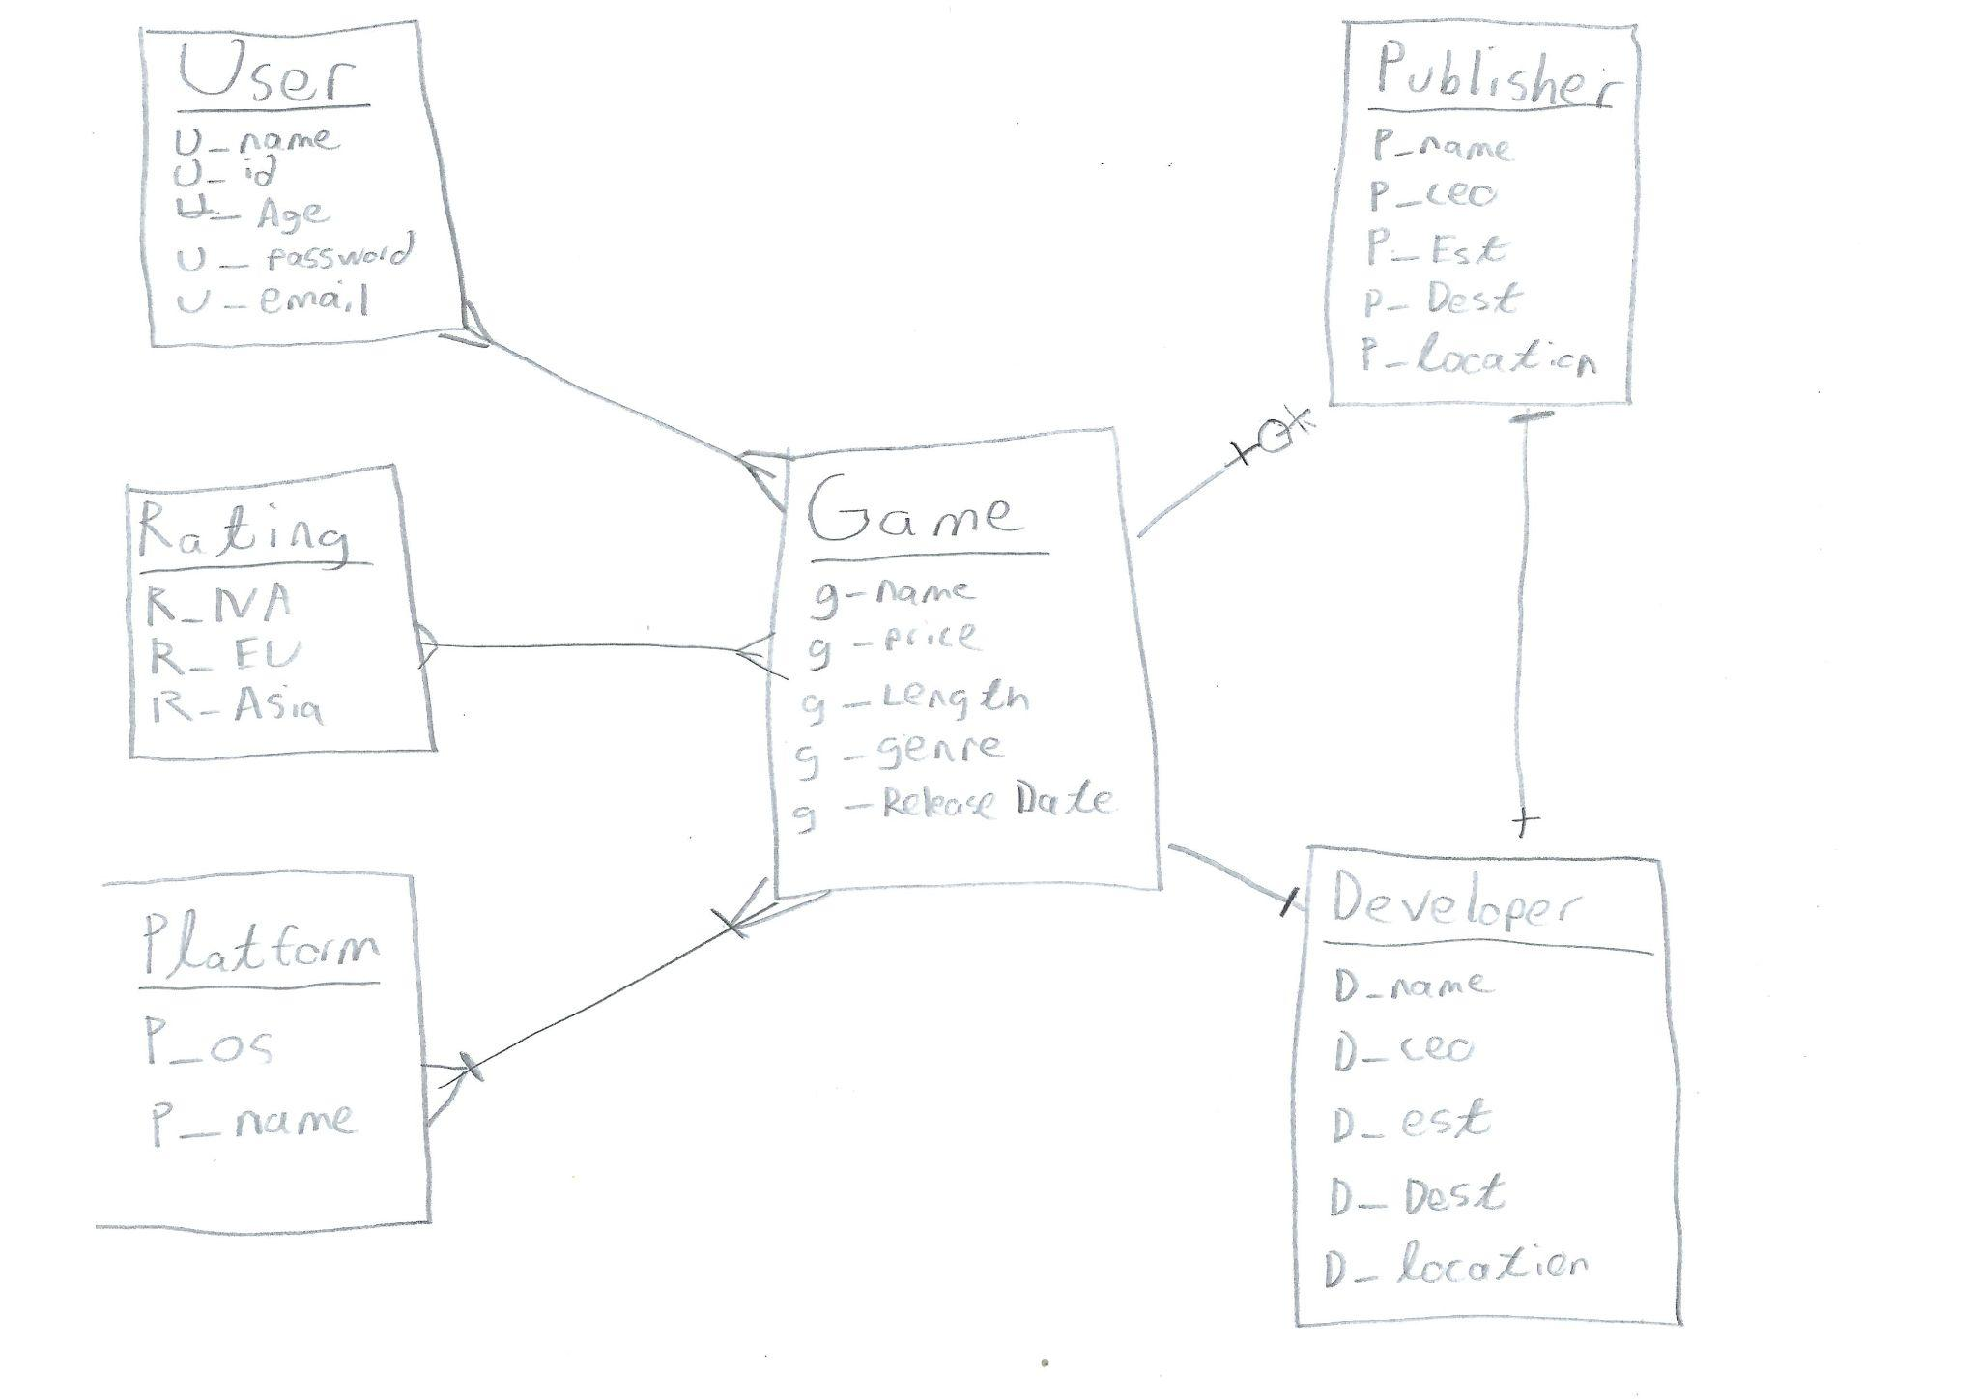
Relational Schema

Slide 6


Implementation Details:
What Database did we use?
How did we build our “Advanced” User Interface?
SQLITE
Python

Slide 7
DEMO

Slide 8
Github
https://github.com/dantuckcse/CSE111-Database

